Slide 1

Chapter 2 Crime Scene
Investigation and Evidence Collection
By the end of this chapter you will be able to:
Define Locard’s exchange principle
Identify four examples of trace evidence
Distinguish between direct and circumstantial (indirect) evidence
Identify the type of professionals who are present at a crime scene.
Write steps of Crime Scene Investigation
Explain the importance of securing the crime scene
Identify the methods by which a crime scene is documented
Demonstrate proper technique in collecting and packaging trace evidence
Forensic Science: Fundamentals & Investigations, Chapter 2

Slide 2
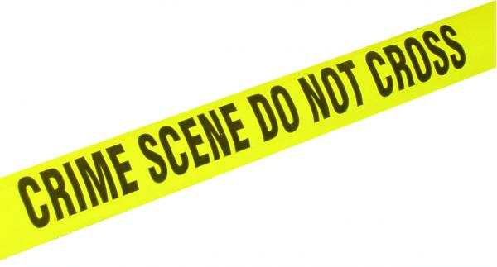
Crime Scene Vocabulary
CRIME SCENE: Any physical location in which a crime has occurred or is suspected of having occurred.
PRIMARY CRIME SCENE: The original location of a crime or accident.
SECONDARY CRIME SCENE: An alternate location where additional evidence may be found.
SUSPECT: Person thought to be capable of committing a crime.
ACCOMPLICE: Person associated with someone suspected of committing a crime.
ALIBI: Statement of where a suspect was at the time of a crime.
Forensic Science: Fundamentals & Investigations, Chapter 2
Source: http://www3.sc.maricopa.edu/ajs/crime_scene_technician.htm

Slide 3
Locard’s Exchange Principle
Established by Dr. Edmond Locard,
the principle states:
When a person comes in contact with an object or another person, a cross-transfer of physical material can occur
(every contact leave a trace)
Study of the material can determine the nature and duration of the transfer
Forensic Science: Fundamentals & Investigations, Chapter 2

Slide 4
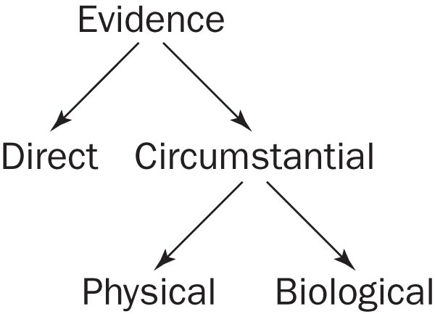
Types of Evidence
Direct evidence
  Testimony by a witness about what that witness saw, heard, or did
  Video tape of crime
  Confession
Forensic Science: Fundamentals & Investigations, Chapter 2

Slide 5
Types of Evidence
Circumstantial evidence
  also called Indirect
Physical evidence
  e.g., fingerprints
Biological evidence
  e.g., blood or hairs
  Note: trace evidence (minute amount of physical or biological evidence)
Forensic Science: Fundamentals & Investigations, Chapter 2

Slide 6
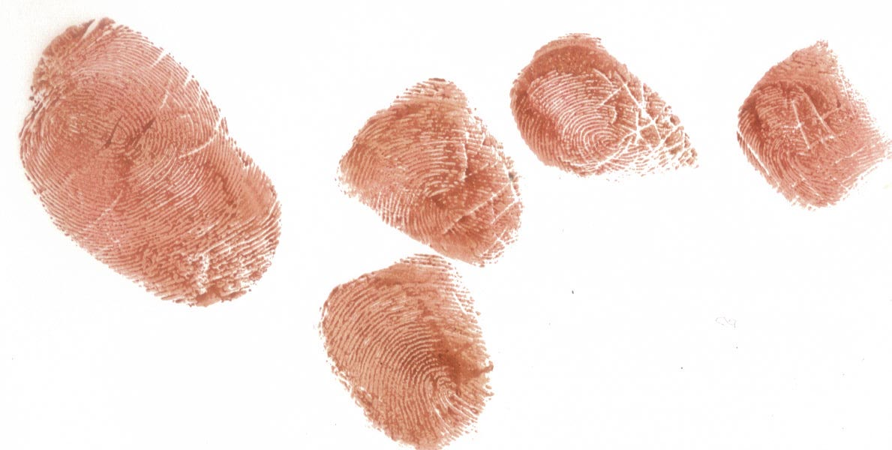
Types of Evidence
Explain why this would be or
would not be trace evidence.
Forensic Science: Fundamentals & Investigations, Chapter 2

Slide 7
Types of Evidence
– individual vs class evidence
Individual evidence – evidence that identifies a particular person or thing
Class evidence – evidence that identifies a certain group.
Forensic Science: Fundamentals & Investigations, Chapter 2

Slide 8
The Crime Scene
Investigation Team
Who is at the crime scene?
Police and
District attorney (possibly)
Crime scene investigators
Medical examiners
Detectives
Specialists
Forensic Science: Fundamentals & Investigations, Chapter 2

Slide 9

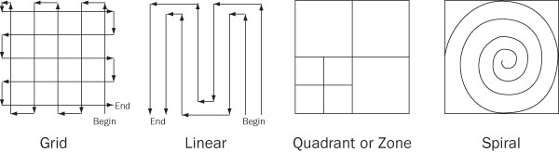
The Steps of Crime Scene Investigation
Secure (isolate) the scene
- includes separating the witnesses
Search the scene systematically (pattern)
3. Document the scene (sketch, photograph, take notes, secure evidence)
Forensic Science: Fundamentals & Investigations, Chapter 2

Slide 10
Documentation of Crime Scene
Photograph
Crime-Scene Sketch (rough/scaled)
Search (patterned) & Properly package the evidence (chain of custody)
Analyze the Evidence (+ record eye witness account-detective)
Crime Scene Reconstruction
Forensic Science: Fundamentals & Investigations, Chapter 2

Slide 11
Photograph in detail
Overview
Mid-range view (be sure to be in middle of an immovable object and the evidence)
Close up view (take one with ruler from a distance and take another perpendicular/directly above of the evidence)
If possible take photo of the other side of the object and the area after object is lifted.
Forensic Science: Fundamentals & Investigations, Chapter 2

Slide 12

Packaging dry evidence – let’s practice
Crease a clean paper and place evidence in the X position
Fold in the left and right sides, and then fold in the top and bottom
Put the bindle into a plastic or paper evidence bag affixing a seal over the opening
Write your name on the seal
If you evidence is wet, it must be place in a breathable bag (i.e. brown bag)
Forensic Science: Fundamentals & Investigations, Chapter 2

Slide 13
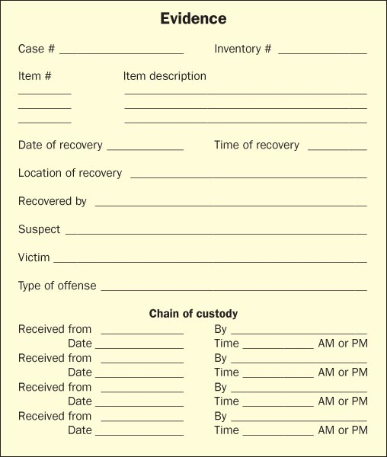
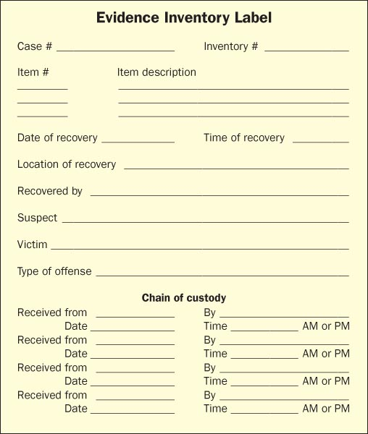
Evidence ID Forms
Forensic Science: Fundamentals & Investigations, Chapter 2

Slide 14
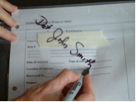
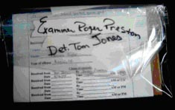
Chain of Custody
Maintaining a chain of custody log is essential to present credible evidence in court
Forensic Science: Fundamentals & Investigations, Chapter 2

Slide 15
Chain of Custody (cont’d.)
Bag the evidence
Add identification
Seal it
Sign it across the sealed edge
Sign over to a lab technician
Open bag on non-sealed edge
Return items to the evidence bag
Seal evidence bag in another bag
Sign the evidence log
Forensic Science: Fundamentals & Investigations, Chapter 2

Slide 16
Analyze the Evidence
Facts result from collected evidence processed by the forensic lab
Lead detective aims to see how facts fit into the crime scenario
Lab results can:
Show reliability of witness accounts
Establish the identity of suspects or victims
Show suspects to be innocent or link them with a scene or victim
Forensic Science: Fundamentals & Investigations, Chapter 2

Slide 17
Staged Crime Scenes
When lab results don’t match up with the testimony of witnesses
Common examples:
Staging a fire—to cover bankruptcy
Staging a suicide—to cover a murder
Staging a burglary—to collect insurance money
Forensic Science: Fundamentals & Investigations, Chapter 2

Slide 18
Crime Scene Reconstruction
Crime scene reconstruction involves:
Forming a hypothesis of the sequence of events
From before the crime was committed through its commission
Forensic Science: Fundamentals & Investigations, Chapter 2

Slide 19

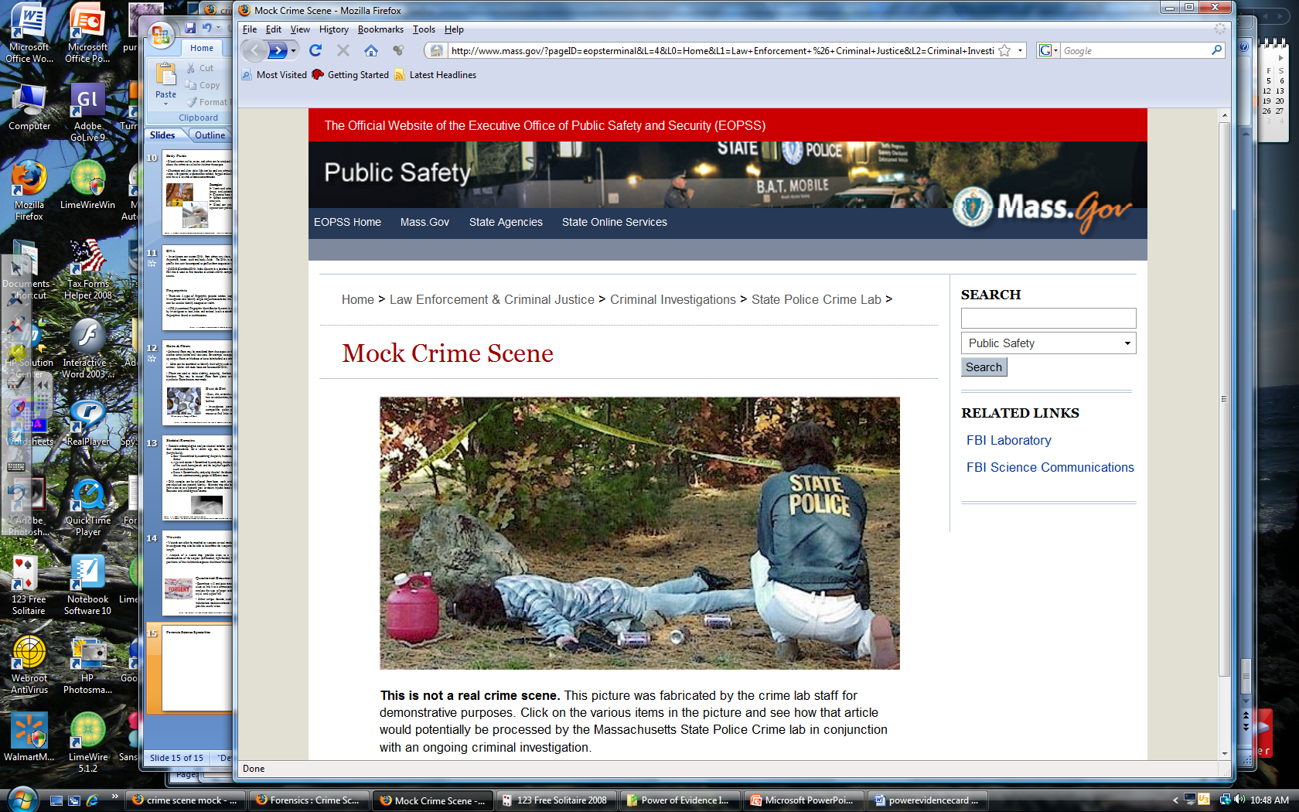
What evidence would you collect?
Forensic Science: Fundamentals & Investigations, Chapter 2
Mock Crime Scene: http://www.masss.gov

